Slide 1
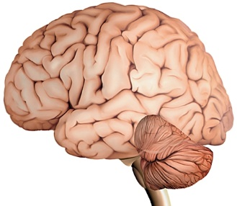
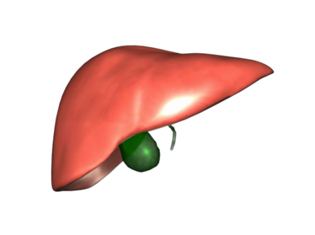
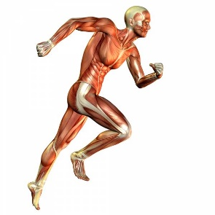
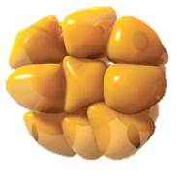
Entrainment
Light
Central Clock
Positive limb
BMAL1
CLOCK
RORα
Core Clock
Rev-erbs
Per
Cry
Negative limb
Peripheral Clock
Food intake
& Exercise
Transcription
Translation
Post-translation
Figure 1
Metabolites

Slide 2
NAM
NAMPT
Glucose
NMN
NAD⁺
Per
Cry
Glycolysis
O-GlcNAcylation
UDP-GlcNAC
Oga
Sirt1
Per
Metabolites
BMAL1
CLOCK
Cry
OGT
Ogt
Rev-erbα/β
Nampt
CACGTG
Rorα
Protein
Protein
E box
Pparα
OGA
G
RORα
Rev-erbs
AMP
ATP
Phosphorylation
AMPK
PPARα
AGGTCA
AGGTCA
Bmal1
Figure 2
PPRE
RORE

Slide 3
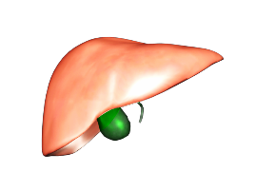
Cardiovascular system
(blood pressure, heart rate)
Skeletal muscle
(glucose uptake, mitochondrial respiration & lipid oxidation)
Thermogenesis
(daily variations in body
temperature)
Intestinal system
(lipid absorption, microbiota, incretins)
Normal clock
Adipocyte differentiation
Liver metabolism
(glucose, lipid, bile acid)
Endocrine systems
(insulin secretion)
Notes:
CircR = A biological rhythm with a ~24-hour (circa diem) period
that persists in constant conditions ; observed in numerous biological processes (BP, HR, rest/active phase alternance, metabolic pathways : glycolysis/gluconeogenesis, hormone secretion (melatonin, cortisol, ..)

