Slide 1
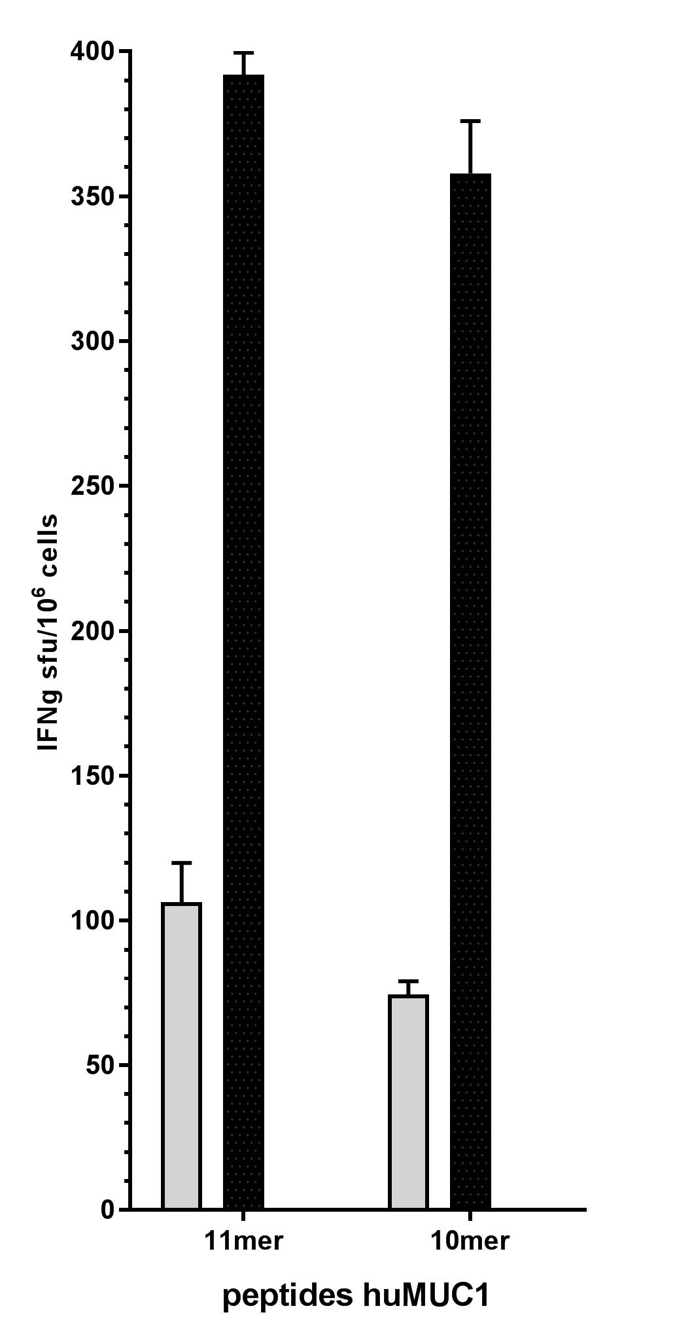
Total splenocytes
CD8-enriched cells
CD8-depleted cells

