Slide 1
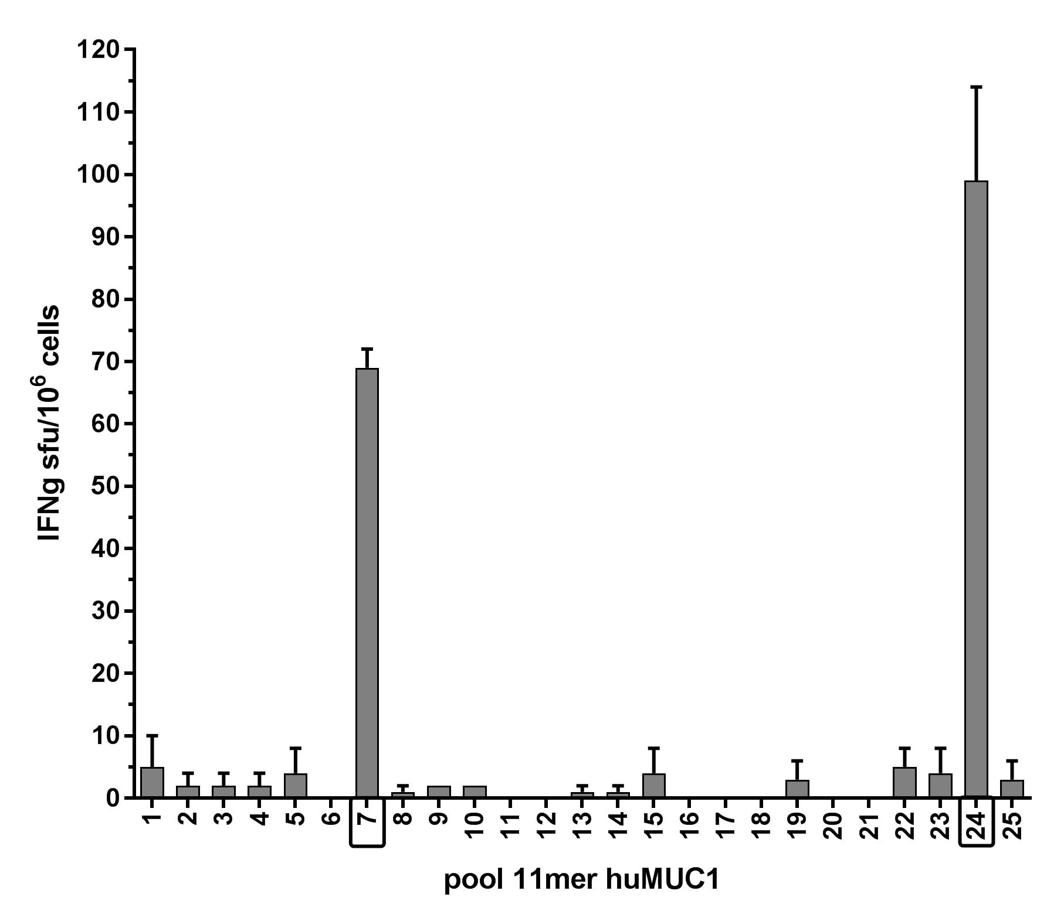
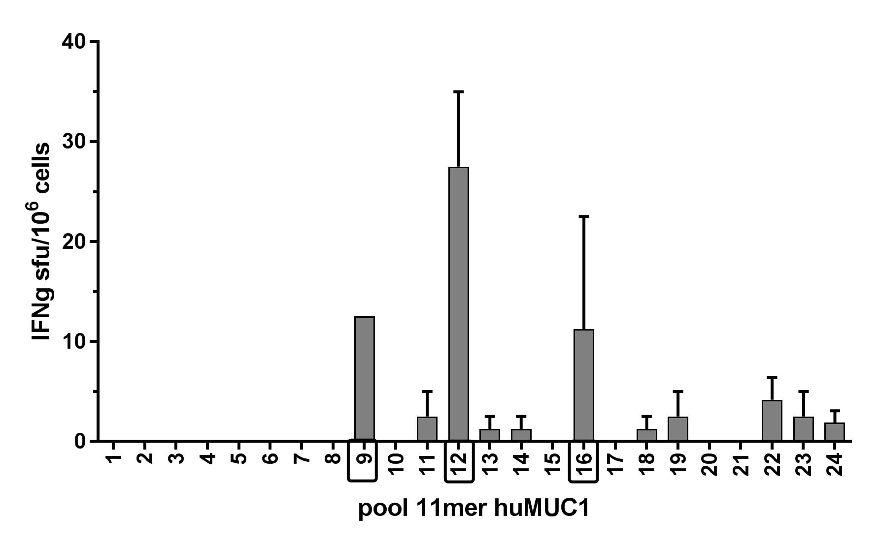
a)
pool 15mer huMUC1
b)
pool 11mer huMUC1
pool 15mer huMUC1
 | Pool | 1 | 2 | 3 | 4 | 5 | 6 | 7 | 8 | 9 | 10 | 11 | 12
 | 13 | 1 | 2 | 3 | 4 | 5 | 6 | 7 | 8 | 9 | 10 | 11 | 12
 | 14 | 13 | 14 | 15 | 16 | 17 | 18 | 19 | 20 | 21 | 22 | 23 | 24
 | 15 | 25 | 26 | 27 | 28 | 29 | 30 | 31 | 32 | 33 | 34 | 35 | 36
 | 16 | 37 | 38 | 39 | 40 | 41 | 42 | 43 | 44 | 45 | 46 | 47 | 48
 | 17 | 49 | 50 | 51 | 52 | 53 | 54 | 55 | 56 | 57 | 58 | 59 | 60
 | 18 | 61 | 62 | 63 | 64 | 65 | 66 | 67 | 68 | 69 | 70 | 71 | 72
 | 19 | 73 | 74 | 75 | 76 | 77 | 78 | 79 | 80 | 81 | 82 | 83 | 84
 | 20 | 85 | 86 | 87 | 88 | 89 | 90 | 91 | 92 | 93 | 94 | 95 | 96
 | 21 | 97 | 98 | 99 | 100 | 101 | 102 | 103 | 104 | 105 | 106 | 107 | 108
 | 22 | 109 | 110 | 111 | 112 | 113 | 114 | 115 | 116 | 117 | 118 | 119 | 120
 | 23 | 121 | 122 | 123 | 124 | 125 | 126 | 127 | 128 | 129 | 130 | 131 | 132
 | 24 | 133 | 134 | 135 | 136 | 137
 | Pool | 1 | 2 | 3 | 4 | 5 | 6 | 7 | 8 | 9 | 10 | 11 | 12
 | 13 | 1 | 2 | 3 | 4 | 5 | 6 | 7 | 8 | 9 | 10 | 11 | 12
 | 14 | 13 | 14 | 15 | 16 | 17 | 18 | 19 | 20 | 21 | 22 | 23 | 24
 | 15 | 25 | 26 | 27 | 28 | 29 | 30 | 31 | 32 | 33 | 34 | 35 | 36
 | 16 | 37 | 38 | 39 | 40 | 41 | 42 | 43 | 44 | 45 | 46 | 47 | 48
 | 17 | 49 | 50 | 51 | 52 | 53 | 54 | 55 | 56 | 57 | 58 | 59 | 60
 | 18 | 61 | 62 | 63 | 64 | 65 | 66 | 67 | 68 | 69 | 70 | 71 | 72
 | 19 | 73 | 74 | 75 | 76 | 77 | 78 | 79 | 80 | 81 | 82 | 83 | 84
 | 20 | 85 | 86 | 87 | 88 | 89 | 90 | 91 | 92 | 93 | 94 | 95 | 96
 | 21 | 97 | 98 | 99 | 100 | 101 | 102 | 103 | 104 | 105 | 106 | 107 | 108
 | 22 | 109 | 110 | 111 | 112 | 113 | 114 | 115 | 116 | 117 | 118 | 119 | 120
 | 23 | 121 | 122 | 123 | 124 | 125 | 126 | 127 | 128 | 129 | 130 | 131 | 132
 | 24 | 133 | 134 | 135 | 136 | 137 | 138 | 139 | 140 | 141 | 142 | 143 | 144
 | 25 | 145 | 146 | 147 | 148 | 149 | 150 | 151 | 152 | 153 | 154 | 155 | 156

